Slide 1
General PTO Meeting
May 10

Slide 2
Agenda
Call to Order/Establish Quorum/ Minutes Approval
Carnival
Budget
Chairs
Parent Social
Elementary Events
Middle School events
Upcoming Events

Slide 3
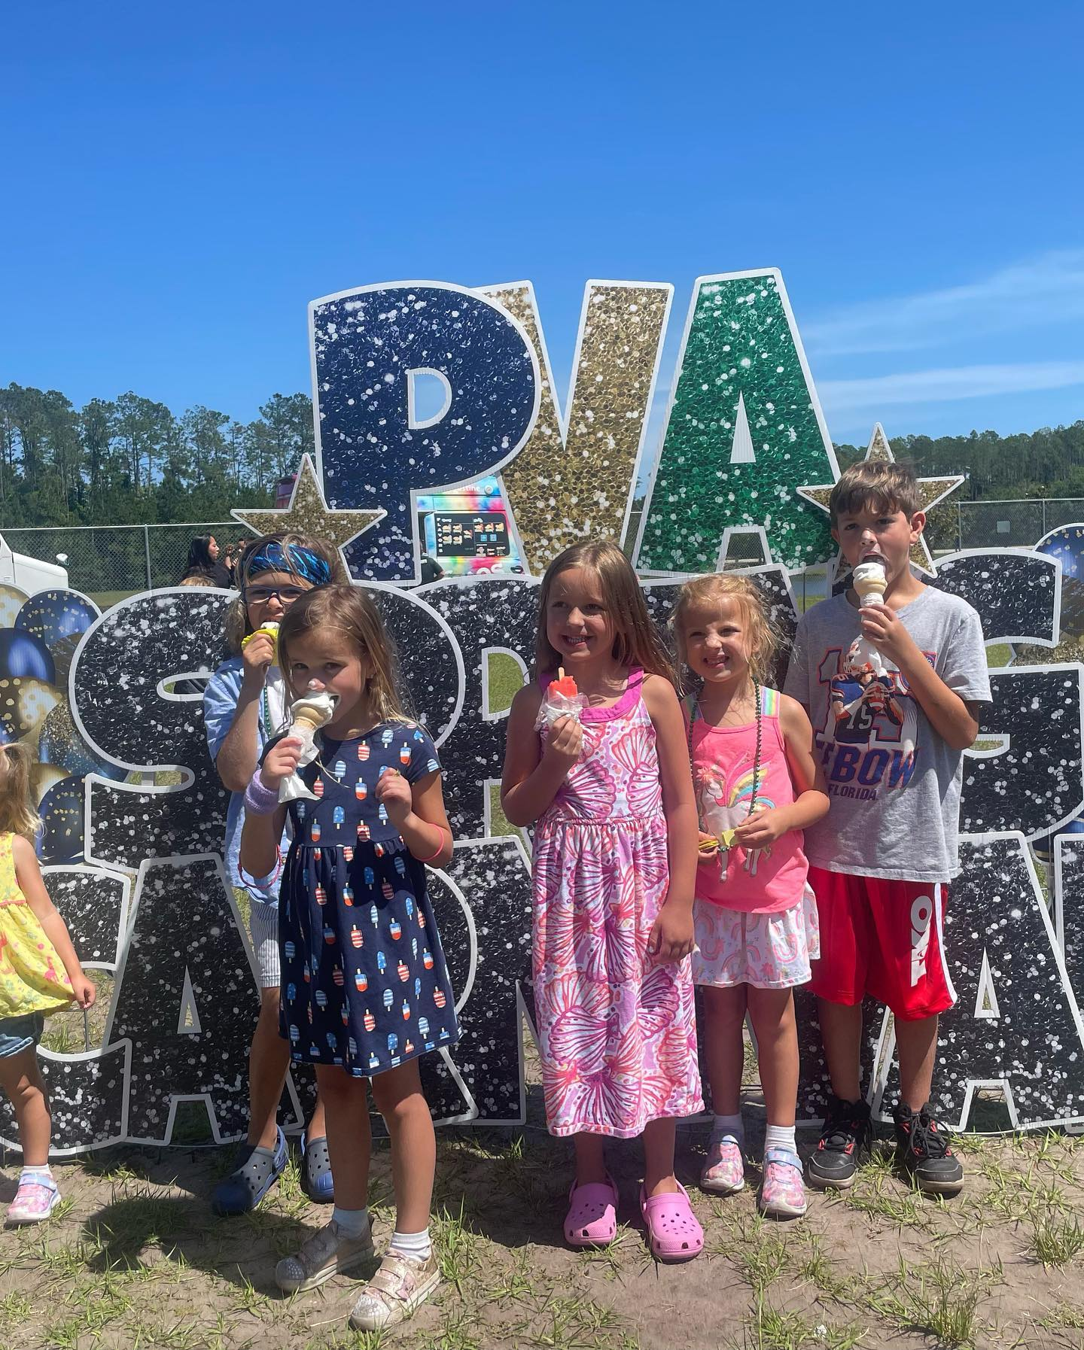
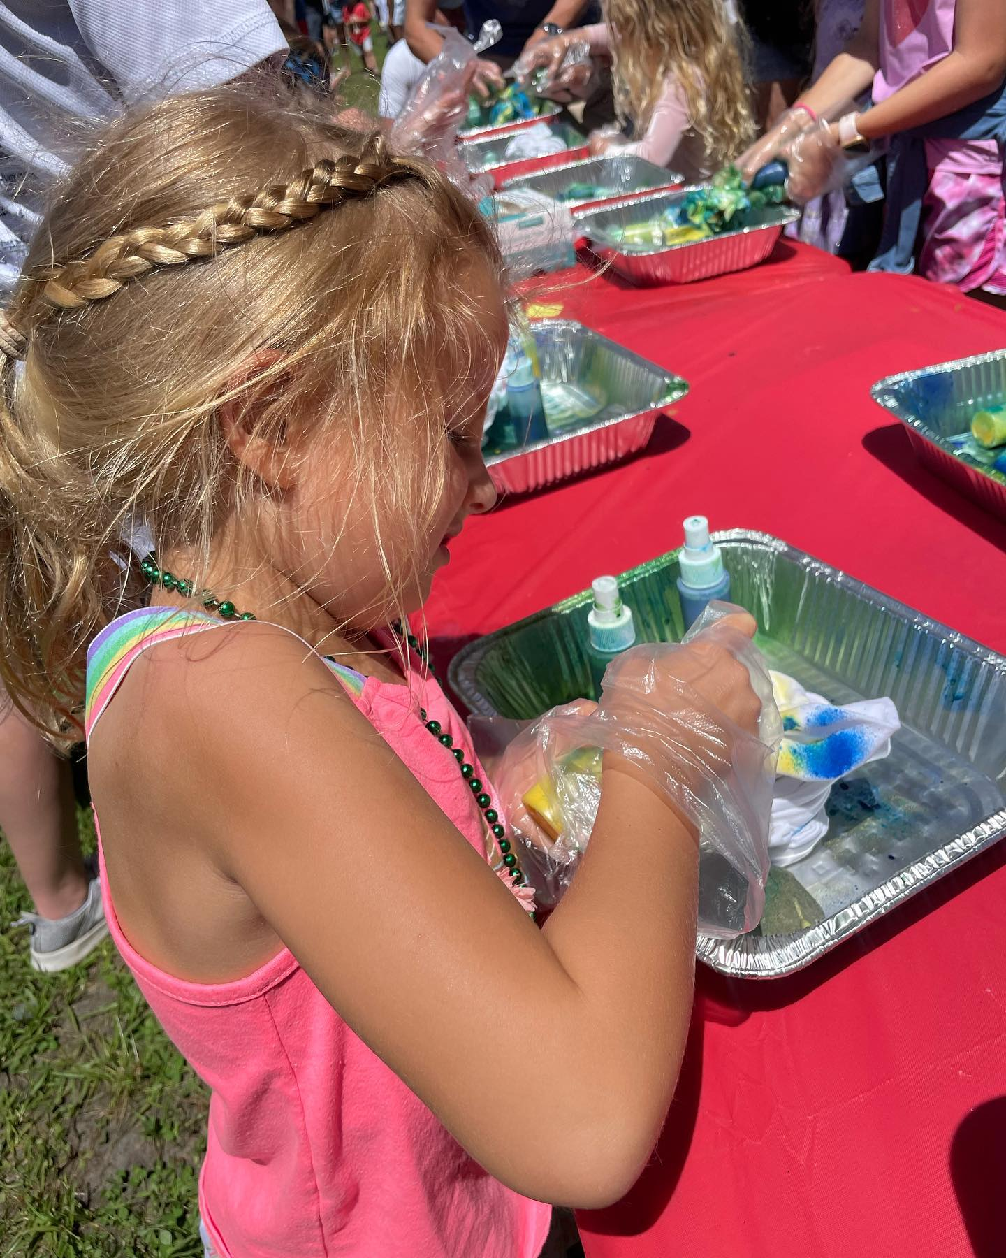
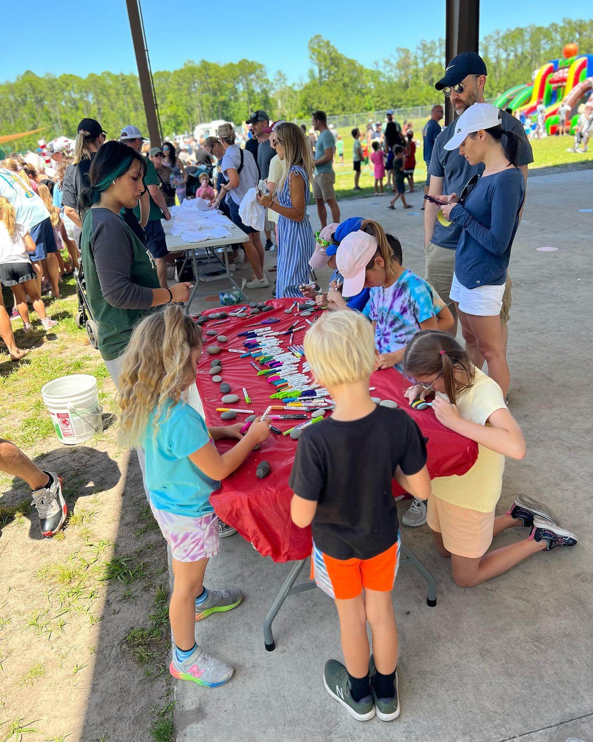
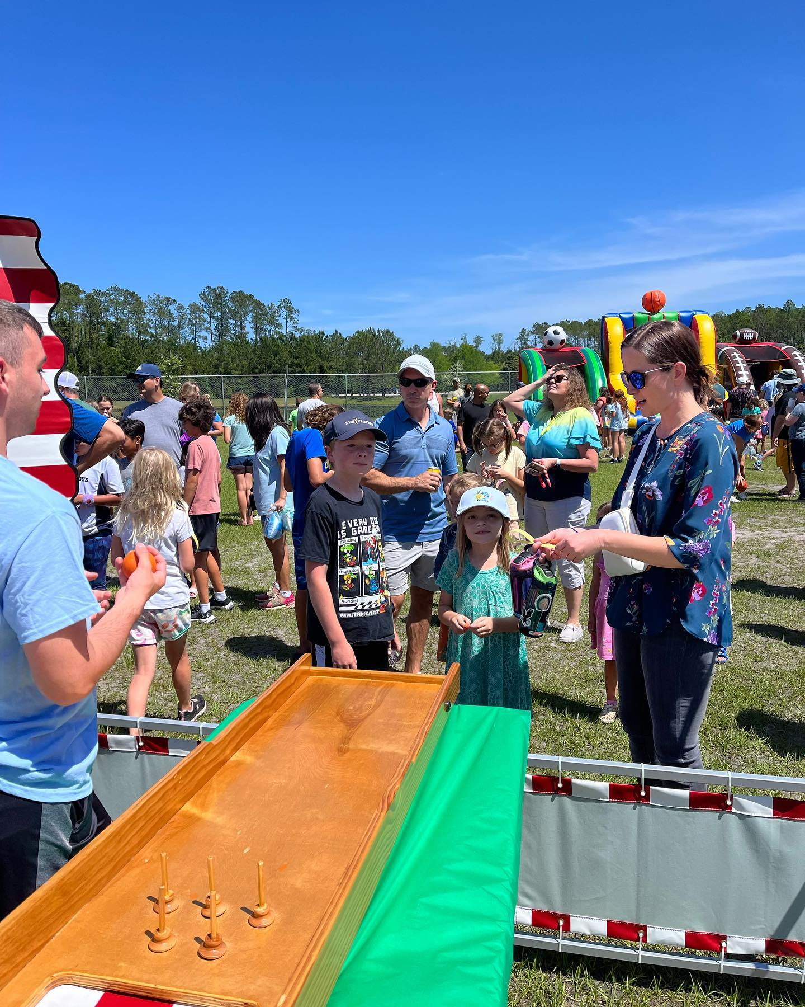
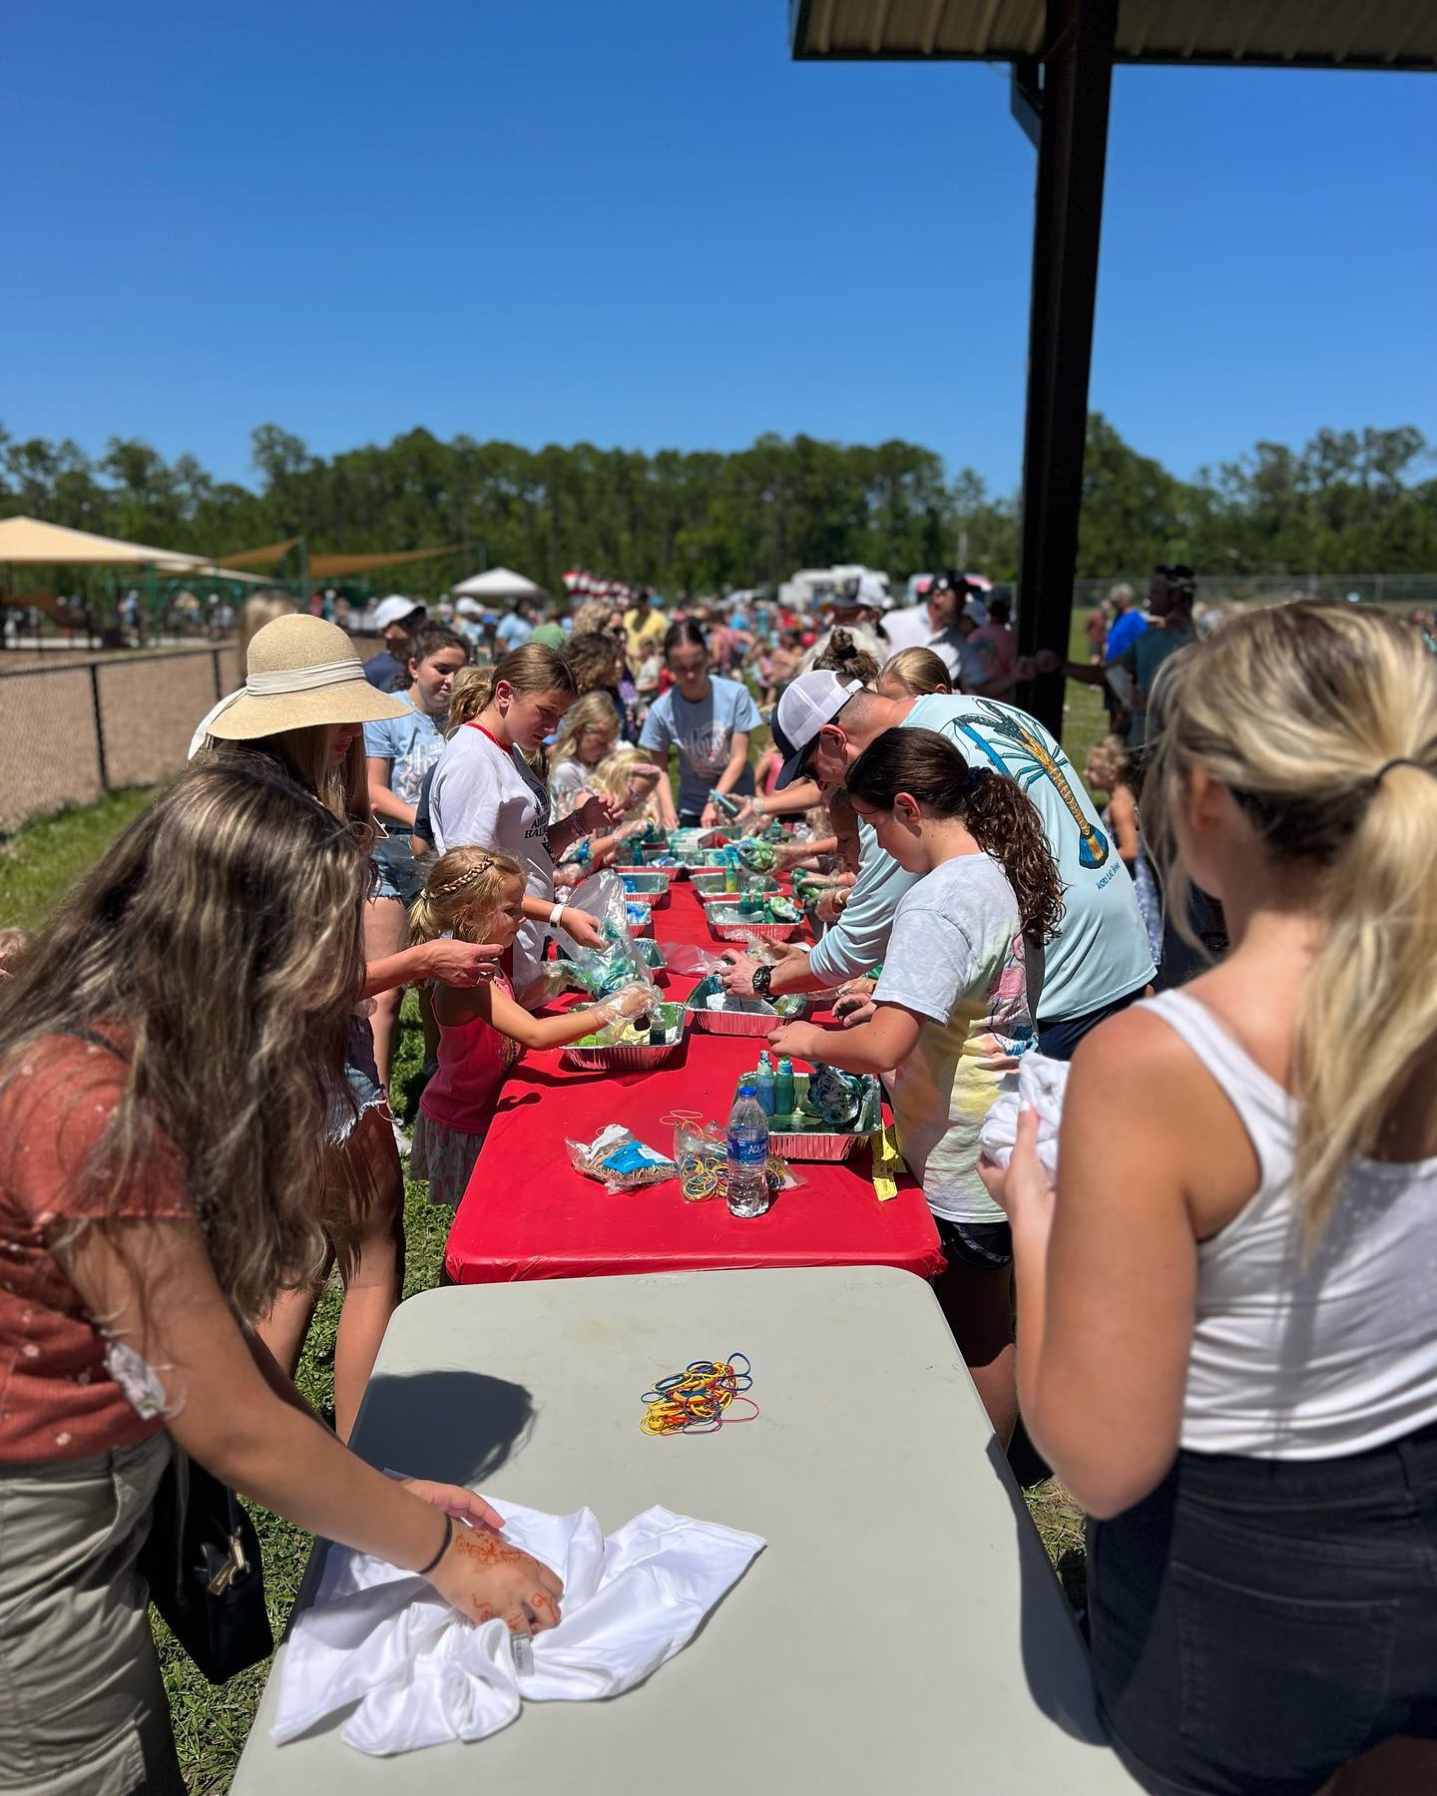
Spring Carnival
Thank you, to all the Volunteers and Staff that helped make this event a success!
We Raised $4,836!!!!

Slide 5
Budget 2023-2024
Overview of 2023-2024 Budget
Questions???
Vote

Slide 6
Chairs
Teacher appreciation Chair
Bingo
Fundraising Chair
Hospitality Chair
Elementary Bolt Chair
8th Grade Promotion Chair
Trunk or Treat Chair
8th Grade Semi-Formal Chair
Elem. Spring Event Chair

Slide 7
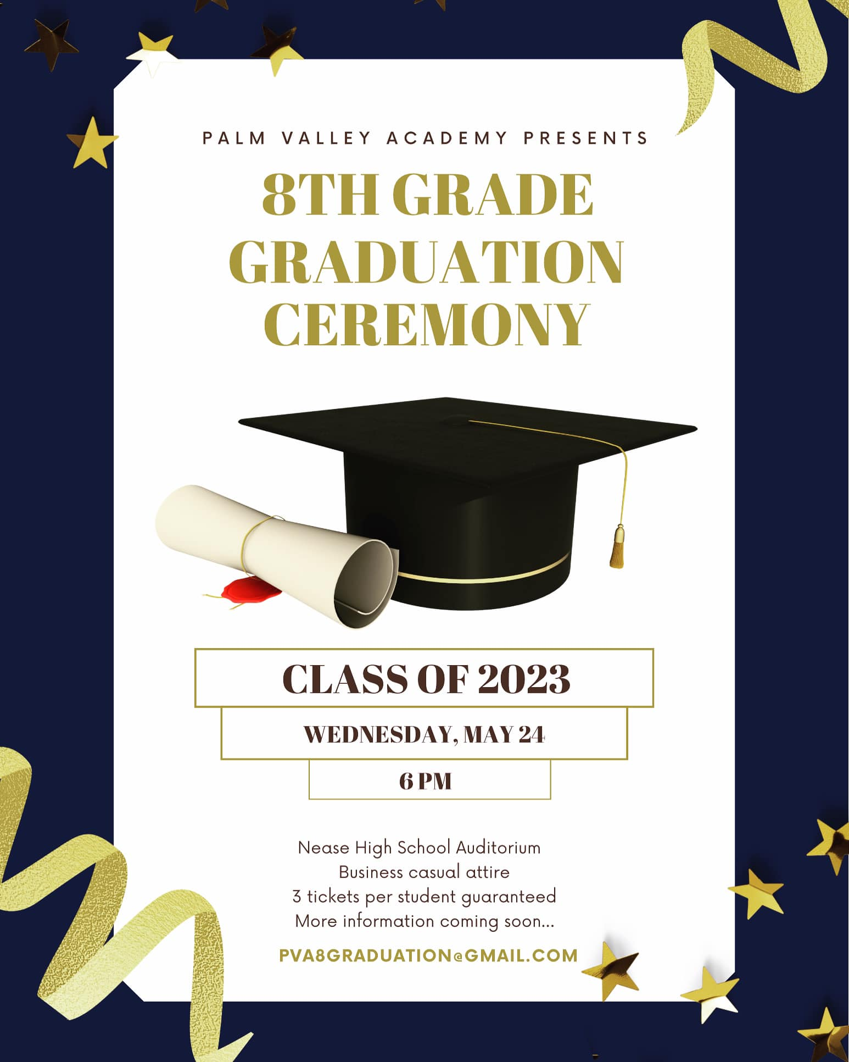
Middle School Events
8th Grade Semi-Formal May 19th
8th Grade Promotion May 24th

Slide 8
Elementary Events
5th Grade Promotion on May 22nd at 8:45am. Please 2 guests per. Student RSVP went home with students last week.
5th Grade Celebration on May 23rd “Amazing Race to Middle School” 9-11:30 am outside under the Pavilion. Glow Party in gym 1-2pm. Only those who signed up are able to attend. At this time all slots have been filled.

Slide 9
Parent Social
PTO parent Social happening this Thursday, May 11th at Really Good Beer Stop!!

Slide 10
Upcoming Events
Papa Johns Spirit Night: May 10th
8th Grade Semi-Formal: May 19th
^{8th Grade Promotion: May 24th}
^{5th Grade Promotion: May 22nd}
5th Grade Celebration: May 23rd

