Slide 1
General PTO Meeting
Wednesday, October 26th – 9 am

Slide 2
Agenda
Call to Order
Establish if quorum is present
August & September meeting minute approval
Voting for open Recording Secretary Position
Fundraising Update
Elementary Events
Committee Chair Update
Upcoming events

Slide 3
Recording Secretary- Candidate Bio
My name is Honesty Harless I would like to tell you a little about
myself. I moved here from Tecumseh, MI in August of 2020. I have one
child, Cadence Harless, that attends Palm Valley Academy. She is in the
4th grade and is currently in Mrs. McClung’s class. I was an Occupational
Therapist for 16yrs before moving down here, currently I am blessed to
be able to stay at home. However, my true passion is volunteering. I
have been on several mission trips to Fort Peck Native American
reservation in Montana. I have worked with my church on community
outreach programs such as cleaning up urban blight in Detroit, food
drives for local shelters, and more. Since moving here I have tried to
volunteer at as many School events as possible which have included;
-Bobcat bolt coordinator -Teacher appreciation week
-Book fair -Picture Day
-Field day -Kindergarten breakfast
-Teacher holiday luncheon.
I would like to continue to serve as your PTO secretary. However, if
that is not possible I would continue to support the PTO in whatever
capacity that may be. I look forward to working with the PTO in the
future and Thankful for the opportunity.

Slide 4
Fundraising Efforts
Little Caesar Pizza Kits
Sold 165 kits of the 200 goal
Equals $990 profit
First Day School Supplies
Check received = $2,689
Upcoming Fundraisers
Dicks Wings Spirit night
Tonight!! Wednesday 26th, 5-10pm. Dine in and Carry out. Must mention PVA for order to count towards our event.
Holiday Spirit Store
Opening for orders 11/1 with all new designs and colors.
Holiday Gift Shop
Nov 28th-Dec 5th
Students will shop during scheduled class time, similar to book fair.
Volunteer signup will be out the week of 11/14.
Start talking at home about who your child will be shopping for and budget to spend for each person.
Gift prices range from $.25-$20.00 per item. Majority of items will be in the $5-$10 range.
Raffle Basket from local businesses
Ticket sales will begin week of 12/5 and we will draw winners 12/19.

Slide 5
Elementary Events
We are looking for volunteers for both the Bobcat Bolt and elementary events committee
Bingo night scheduled for November 18th
Starting the planning for a large scale event in the spring but we need volunteers
Want an event at PVA? email vpelementary@pvapto.org

Slide 6
Committee Chairs Thank you to our volunteers!
Committee Chair Positions Currently Filled
Volunteer Coordinator | Amy
Partners In Education | Bev Ardibili
CAT Chair | Katie Berseth
Teacher Appreciation Week Co-Chair | Jessica Dareneau
Teacher Appreciation Week Co-Chair | Alli Thomas
Book Fair Co-Chair | Sabra Sanchez
Book Fair Co-Chair | Viviana Cardona
5th Grade Celebration | Laura Gainor
Membership Chair | Brittney Hulsey
Committee Chair Positions Open
Apparel Chair | Sonja Lott
8th Grade Promotion Chair | Mia Azotea
8th Grade Semi-formal Chair | Laura Freeman
Elementary Events Co-Chair | Andrea Baker
Elementary Events Co-Chair | Brittney Hulsey
Elementary Bolt Co-Chair | Jessica Dareneau
Elementary Bolt Co-Chair | Alli Thomas
MS Bolt/Glow Run Chair | Hannah Devries

Slide 7
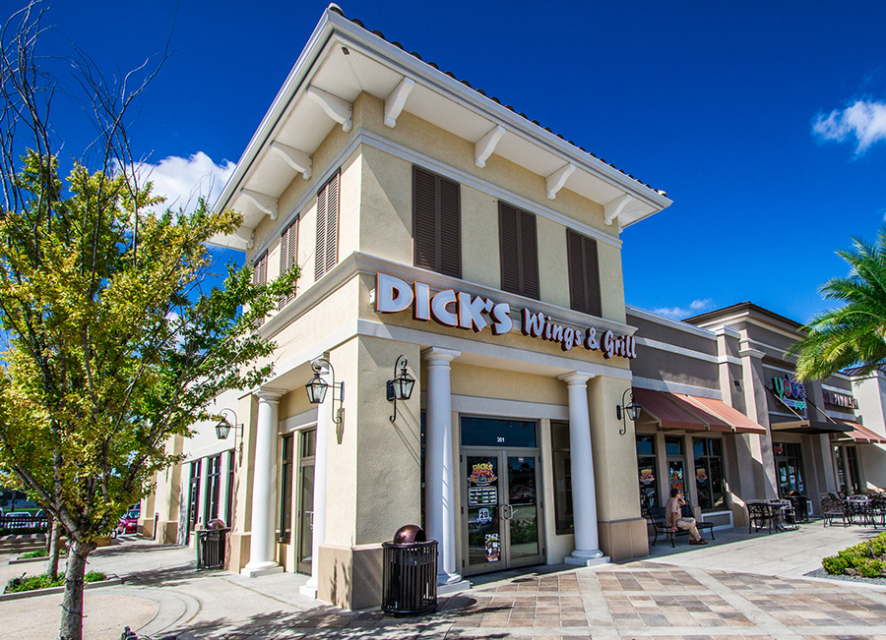
Upcoming Events
Spirit Night- Today! October 26th Dick’s
Apparel Store opening- November 1st with new designs!
Holiday Shop-Tuesday, Nov 29th-Thursday, Dec 8th
Next General PTO Meeting- November 17th at 9 am
Bobcat Bolt:
Elementary: February 7th & 9th
Middle School: February 10th
^{Other School Updates}
Lunch room volunteers- sign ups are open!
Middle School Dance- November 10th 5-7 pm (Sponsored by NJHS/Student Government)
Social media sports updates can be added if post is sent to PTO media.

