Slide 1
Palm Valley Academy PTO Principal Coffee Chat September 10th, 2018
Building Purposeful Leaders Where Everyone Shines Through Achievement

Slide 2
PVA Staff 123 Strong PVA Students- 1290 and counting….
Jessica Richardson/Drew Chiodo and Zach Strom | Principal/Assistant Principals
Jake O’Keefe | Dean of Students
Joyce Ward | Confidential Secretary
Mary Dominguez | Registrar/Computer Operator
Tyson Shank | Maintenance Manager
Christopher Parker | Food Service Manager
Jessica Hamelin | Instructional Literacy Coach
Alice Fasula | Nurse
Jason Sands | Technology Support Specialist
Karin Ngai-Crim, Dorrie Lombardi, Taneen Delaney | Guidance Counselors
ESE: 4, SLPs: 2, OT, PT | Team Leader- Tracie Scales
Resource 9 | Team Leader- Al Henson
Kindergarten: 11 | Team Leader- Andrea Bell
First Grade: 10 + 1 Associate Teacher | Team Leader- Ashlyn Ahearn
Second Grade: 10 + 1 Associate Teacher | Team Leader- Liza Rogers
Third Grade: 10 + 1 Associate Teacher (TBA) | Team Leader- Heidi Taylor
Fourth Grade: 8 + 1 Associate Teacher | Team Leader- Janine Beaulieu
Fifth Grade: 9 | Team Leader: Debbie Dykes
Sixth Grade: 7- 1 TBA | Team Leader: Amanda Dehner

Slide 3
The St. Johns County School District will inspire good character and a passion for lifelong learning in all students, creating educated and caring contributors to the world.
All students will choose a learning path that leads to a well-rounded graduate who demonstrates good character and leadership.

Slide 4
Notes:
Who we are! Our Purpose

Slide 5
THE PLAN
Heart
Collaboration
Head
SUCCESS FOR ALL
Notes:
Read letter from Flip Flippen here

Slide 6
The Bobcat Way CKH- Creating EXCEL LEADERS
Notes:
relationship, leadership, teaching

Slide 7
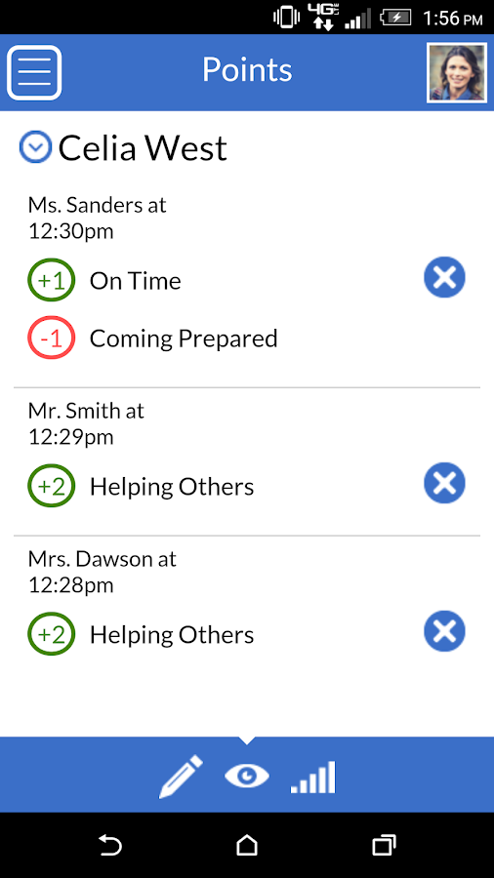
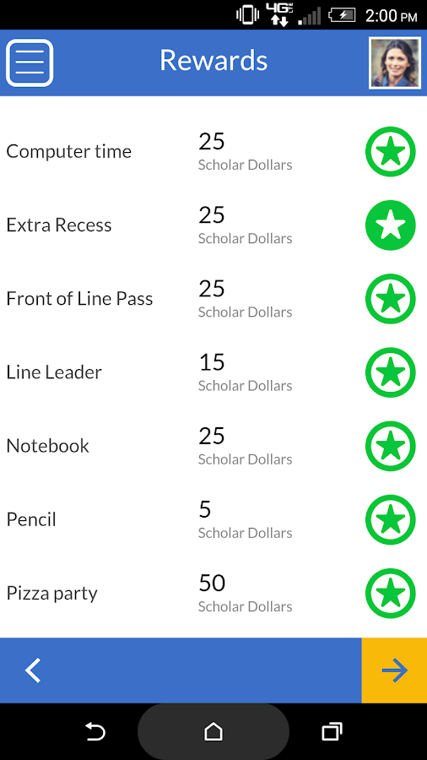

Slide 8
The Bobcat Way- EXCEL LEADERS
ENGAGE- Handshake, Welcome, Affirm
Committed to the Process

Slide 9
The Bobcat Way- EXCEL LEADERS
EXPLORE- Customer’s Needs, Listening Skills, Safe Environment
You can do this too…

Slide 11
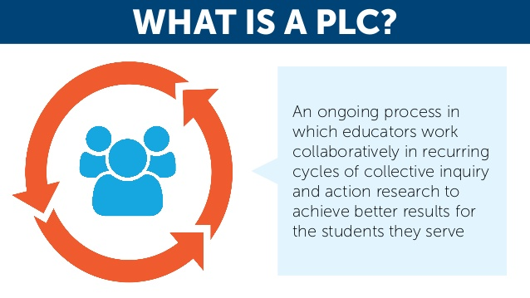
The Bobcat Way- EXCEL LEADERS
Communicate and Empower
Student-Centered Learning

Slide 12
PLC Collaboration Blocks: What are students are gaining.
1:15 pm- 1:50 pm
Planning 5 | 1st Grade | 3rd Grade |  | 2nd Grade | Kindergarten
PE - Henson | Adamo | Arcuri |  | Coppes/ Harkness | Bell/Sisneroz
Typing- Media para | Justice/Knapp | Buckner |  | Hoessler | Bishop/ Peters
Art -Holland | Beamer | Kelley |  | O'Keefe | Booth
Media-Neff | Latzko | Kokos |  | Poeun | Sandoval-Beatty
PE-Anderson | McVay | Mancino |  | Rogers | Vincent
Guidance-Counselors | Powell | Phillips/Dinkins |  | Shilling | Trebony
STEAM- Wade | Ridout | Taylor |  | Meyers | Rogers
Music -Price | Sgroi | Harrah |  | Giampetro | Ruiz
American Sign Language | Anderson | Schickley |  | Morris | Carter
1:55 pm- 2:30 pm
Planning 5 | 1st Grade | 3rd Grade |  | 2nd Grade | Kindergarten
PE - Henson | Justice/Knapp | Buckner |  | Hoessler | Bishop/ Peters
Typing- Media para | Beamer | Kelley |  | O'Keefe | Booth
Art -Holland | Latzko | Kokos |  | Poeun | Sandoval-Beatty
Media-Neff | McVay | Mancino |  | Rogers | Vincent
PE-Anderson | Powell | Phillips/Dinkins |  | Shilling | Tebony
Guidance-Counselors | Ridout | Taylor |  | Meyers | Rogers
STEAM- Wade | Sgroi | Harrah |  | Giampetro | Ruiz
Music -Price | Anderson | Schickley |  | Morris | Carter
American Sign Language | Adamo | Arcuri |  | Coppes/ Harkness | Bell/Sisneroz

Slide 13
Common Commitments
Common Assessments
Formatives
Summatives
Reteach and Retest (3rd grade and up)
Any student who scores below an 80% on CSA
will receive remediation and will retest the specific standard(s) for full credit.
The lowest grade that will be entered into a gradebook is a 49.99%
Common Grading
Common Homework
CS
fff fff
CF CF
fff fff fff fff fff

Slide 14
Relevant, Real-World, “I Care”

Slide 15
The Bobcat Way- EXCEL LEADERS
LAUNCH
End and Send
Summary
Commitment to Action
Passion

